Slide 1
COMP 2710 Software Construction
Homework 1
Standard Class String
Function Basics
Dr. Alvin Lim
Auburn University
http://www.eng.auburn.edu/~lim
limalvi@auburn.edu
Fall 2014
These slides are adapted from notes by Dr. Walter Savitch (UCSD)
1-<number>

Slide 2
Homework 1 – How to compile?
/* To compile:
1. type "g++ hw1.cpp -o hw1" in a terminal window to create hw1 executable file; re-executing this will update the hw1 file
2. type "g++ hw1.cpp" to create and update the a.out with the latest code
3. type "./a.out" or “./hw1” to run the program */
1-<number>

Slide 3
Pitfall 2 – How to name your source code?
Wrong: hw1.txt
Correct: hw1.cpp
1-<number>

Slide 4
Standard Class String
These slides are adapted from notes by Dr. Walter Savitch (UCSD)
1-<number>

Slide 5
Standard Class string
Defined in library:
#include <string>
using namespace std;
String variables and expressions
  Treated much like simple types
Can assign, compare, add:
string s1, s2, s3;
s3 = s1 + s2; //Concatenation
s3 = "Hello Mom!" //Assignment
  Note c-string "Hello Mom!" automatically
  converted to string type!
9-<number>
Copyright © 2010 Pearson Addison-Wesley. All rights reserved.

Slide 6
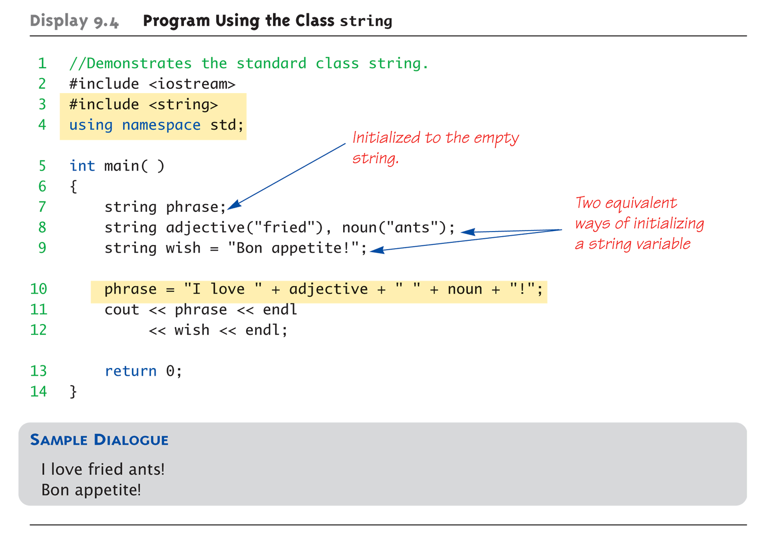
Display 9.4
Program Using the Class string
Copyright © 2010 Pearson Addison-Wesley. All rights reserved.
9-<number>

Slide 7
I/O with Class string
Just like other types!
string s1, s2;
cin >> s1;
cin >> s2;
Results:
User types in:
May the hair on your toes grow long and curly!
Extraction still ignores whitespace:
s1 receives value "May"
s2 receives value "the"
9-<number>
Copyright © 2010 Pearson Addison-Wesley. All rights reserved.

Slide 8
getline() with Class string
For complete lines:
string line;
cout << "Enter a line of input: ";
getline(cin, line);
cout << line << "END OF OUTPUT";
Dialogue produced:
Enter a line of input: Do be do to you!
Do be do to you!END OF INPUT
  Similar to c-string’s usage of getline()
9-<number>
Copyright © 2010 Pearson Addison-Wesley. All rights reserved.

Slide 9
Other getline() Versions
Can specify "delimiter" character:
string line;
cout << "Enter input: ";
getline(cin, line, "?");
  Receives input until "?" encountered
getline() actually returns reference
  string s1, s2;
  getline(cin, s1) >> s2;
  Results in: (cin) >> s2;
9-<number>
Copyright © 2010 Pearson Addison-Wesley. All rights reserved.

Slide 10
Pitfall: Mixing Input Methods
Be careful mixing cin >> var and getline
  int n;
  string line;
  cin >> n;
  getline(cin, line);
  If input is: 42
  Hello hitchhiker.
    Variable n set to 42
    line set to empty string!
  cin >> n skipped leading whitespace, leaving
  "\n" on stream for getline()!
9-<number>
Copyright © 2010 Pearson Addison-Wesley. All rights reserved.

Slide 11
Class string Processing
Same operations available as c-strings
And more!
  Over 100 members of standard string class
Some member functions:
  .length()
    Returns length of string variable
  .at(i)
    Returns reference to char at position i
9-<number>
Copyright © 2010 Pearson Addison-Wesley. All rights reserved.

Slide 12
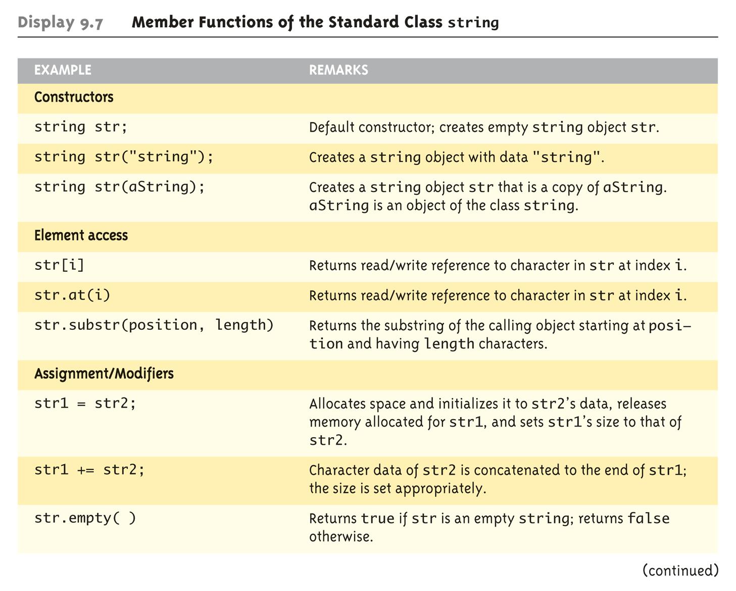
Display 9.7 Member Functions of the Standard Class string (1 of 2)
Copyright © 2010 Pearson Addison-Wesley. All rights reserved.
9-<number>

Slide 13
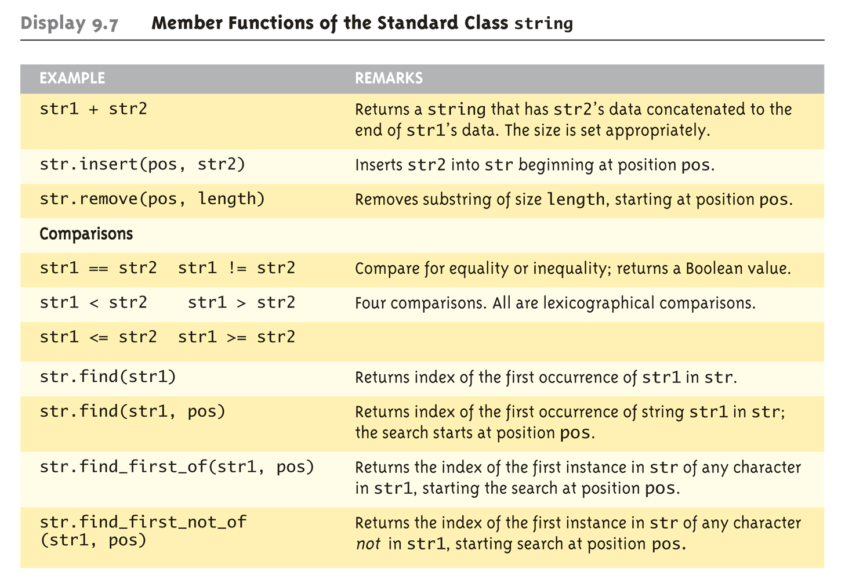
Display 9.7 Member Functions of the Standard Class string (2 of 2)
Copyright © 2010 Pearson Addison-Wesley. All rights reserved.
9-<number>

Slide 14
Class string Reference
For a complete list of string function, see:
  http://www.cppreference.com/wiki/string/start
9-<number>
Copyright © 2010 Pearson Addison-Wesley. All rights reserved.

Slide 15
Flow of Control 2
These slides are adapted from notes by Dr. Walter Savitch (UCSD)
Notes:
See Lecture 2

Slide 16
Loops
3 Types of loops in C++
  while
    Most flexible
    No "restrictions"
  do-while
    Least flexible
    Always executes loop body at least once
  for
    Natural "counting" loop
Copyright © 2008 Pearson Addison-Wesley. All rights reserved.
2-<number>

Slide 17
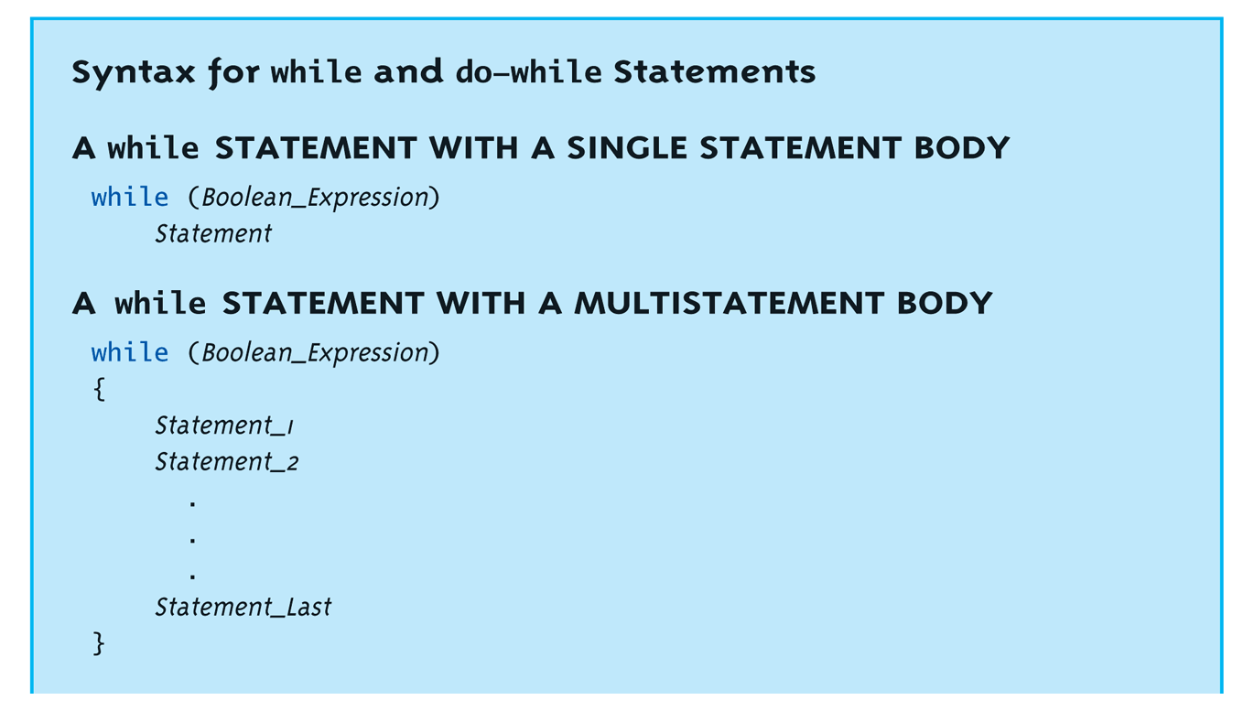
while Loops Syntax: Display, page 69
Copyright © 2008 Pearson Addison-Wesley. All rights reserved.
2-<number>

Slide 18
while Loop Example
Consider:
count = 0; // Initialization
while (count < 3) { // Loop Condition
cout << "Hi "; // Loop Body
count++; // Update expression
}
  Loop body executes how many times?
Copyright © 2008 Pearson Addison-Wesley. All rights reserved.
2-<number>
Notes:
3

Slide 19
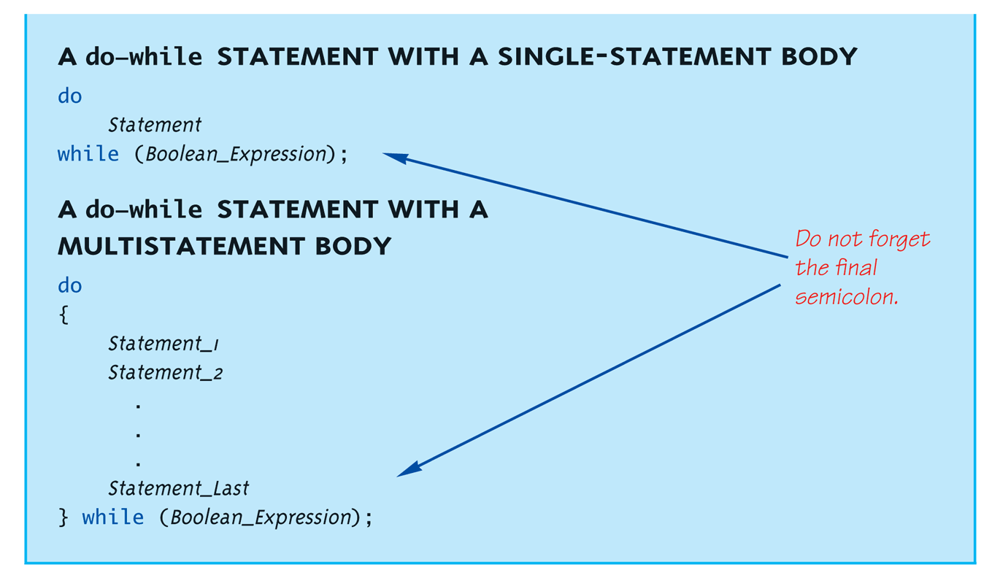
do-while Loop Syntax:
Display, page 70
Copyright © 2008 Pearson Addison-Wesley. All rights reserved.
2-<number>

Slide 20
do-while Loop Example
count = 0; // Initialization
do
{
cout << "Hi "; // Loop Body
count++; // Update expression
} while (count < 3); // Loop Condition
  Loop body executes how many times?
  do-while loops always execute body at least once!
Copyright © 2008 Pearson Addison-Wesley. All rights reserved.
2-<number>
Notes:
3

Slide 21
while vs. do-while
Very similar, but…
  One important difference
    Issue is "WHEN" boolean expression is checked
    while: checks BEFORE body is executed
    do-while: checked AFTER body is executed
After this difference, they’re
essentially identical!
while is more common, due to it’s
ultimate "flexibility"
Copyright © 2008 Pearson Addison-Wesley. All rights reserved.
2-<number>

Slide 22
Comma Operator
Evaluate list of expressions, returning
value of the last expression
Most often used in a for-loop
Example:
first = (first = 2, second = first + 1);
  first gets assigned the value 3
  second gets assigned the value 3
No guarantee what order expressions will
be evaluated.
Copyright © 2008 Pearson Addison-Wesley. All rights reserved.
2-<number>

Slide 23
for Loop Syntax
for (Init_Action; Bool_Exp; Update_Action)
Body_Statement
Like if-else, Body_Statement can be
a block statement
  Much more typical
Copyright © 2008 Pearson Addison-Wesley. All rights reserved.
2-<number>
Notes:
Java:
for ( i=1; i<6; i++ ) {
System.out.println(i);
}

Slide 24
for Loop Example
for (count=0; count<3; count++)
{
cout << "Hi "; // Loop Body
}
How many times does loop body execute?
Initialization, loop condition and update all
"built into" the for-loop structure!
A natural "counting" loop
Copyright © 2008 Pearson Addison-Wesley. All rights reserved.
2-<number>
Notes:
3

Slide 25
Loop Issues
Loop’s condition expression can be ANY boolean expression
Examples:
  while (count<3 && done!=0)
  {
  // Do something
  }
  for (index=0; index<10 && entry!=-99; index++)
  {
  // Do something
  }
Copyright © 2008 Pearson Addison-Wesley. All rights reserved.
2-<number>

Slide 26
Loop Pitfalls: Misplaced ;
Watch the misplaced ; (semicolon)
  Example:
  while (response != 0) ;←
  {
  cout << "Enter val: ";
  cin >> response;
  }
  Notice the ";" after the while condition!
Result here: INFINITE LOOP!
Copyright © 2008 Pearson Addison-Wesley. All rights reserved.
2-<number>

Slide 27
Loop Pitfalls: Infinite Loops
Loop condition must evaluate to false at
some iteration through loop
  If not → infinite loop.
  Example:
  while (1) {
  cout << "Hello ";
  }
  A perfectly legal C++ loop → always infinite!
Infinite loops can be desirable
  e.g., "Embedded Systems"
Copyright © 2008 Pearson Addison-Wesley. All rights reserved.
2-<number>
Notes:
How about while (true) {}
How about while (false) {}

Slide 28

The break and continue Statements
Flow of Control
  Recall how loops provide "graceful" and clear flow of control in and out
  In RARE instances, can alter natural flow
break;
  Forces loop to exit immediately.
continue;
  Skips rest of loop body
These statements violate natural flow
  Only used when absolutely necessary!
Copyright © 2008 Pearson Addison-Wesley. All rights reserved.
2-<number>

Slide 29
Nested Loops
Recall: ANY valid C++ statements can be
inside body of loop
This includes additional loop statements!
  Called "nested loops"
Requires careful indenting:
for (outer=0; outer<5; outer++)
for (inner=7; inner>2; inner--)
cout << outer << inner;
  Notice no { } since each body is one statement
  Good style dictates we use { } anyway
Copyright © 2008 Pearson Addison-Wesley. All rights reserved.
2-<number>

Slide 30
Summary
C++ loop statements
  while
  do-while
  For
do-while loops
  Always execute their loop body at least once
for-loop
  A natural "counting" loop
Loops can be exited early
  break statement
  continue statement
  Usage restricted for style purposes
Copyright © 2008 Pearson Addison-Wesley. All rights reserved.
2-<number>

Slide 31
Function Basics
These slides are adapted from notes by Dr. Walter Savitch (UCSD)
1-<number>
Notes:
Objectives
Predefined Functions
Those that return a value and those that don’t
Programmer-defined Functions
Defining, Declaring, Calling
Recursive Functions
Scope Rules
Local variables
Global constants and global variables
Blocks, nested scopes

Slide 32
Introduction to Functions
Building Blocks of Programs
Other terminology in other languages:
  Procedures, subprograms, methods
  In C++: functions
I-P-O
  Input – Process – Output
  Basic subparts to any program
  Use functions for these "pieces"
Copyright © 2008 Pearson Addison-Wesley. All rights reserved.
3-<number>
1-<number>

Slide 33
Predefined Functions
Libraries full of functions for our use!
Two types:
  Those that return a value
  Those that do not (void)
Must "#include" appropriate library
  e.g.,
    <cmath>, <cstdlib> (Original "C" libraries)
    <iostream> (for cout, cin)
Copyright © 2008 Pearson Addison-Wesley. All rights reserved.
3-<number>
1-<number>

Slide 34
Using Predefined Functions
Math functions very plentiful
  Found in library <cmath.h>
  Most return a value (the "answer")
Example: theRoot = sqrt(9.0);
  Components:
  sqrt = name of library function
  theRoot = variable used to assign "answer" to
  9.0 = argument or "starting input" for function
  In I-P-O:
    I = 9.0
    P = "compute the square root"
    O = 3, which is returned & assigned to theRoot
Copyright © 2008 Pearson Addison-Wesley. All rights reserved.
3-<number>
1-<number>

Slide 35
The Function Call
Back to this assignment:
theRoot = sqrt(9.0);
  The expression "sqrt(9.0)" is known as a
  function call, or function invocation
  The argument in a function call (9.0) can be a
  literal, a variable, or an expression
  The call itself can be part of an expression:
    bonus = sqrt(sales)/10;
    A function call is allowed wherever it’s legal to use
    an expression of the function’s return type
Copyright © 2008 Pearson Addison-Wesley. All rights reserved.
3-<number>
1-<number>

Slide 36
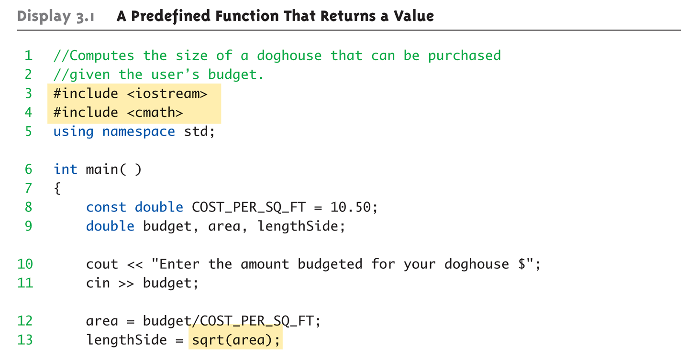
A Larger Example:
Display 3.1 A Predefined Function That Returns a Value (1 of 2)
Copyright © 2008 Pearson Addison-Wesley. All rights reserved.
3-<number>
1-<number>
Notes:
doghouse.cpp

Slide 37
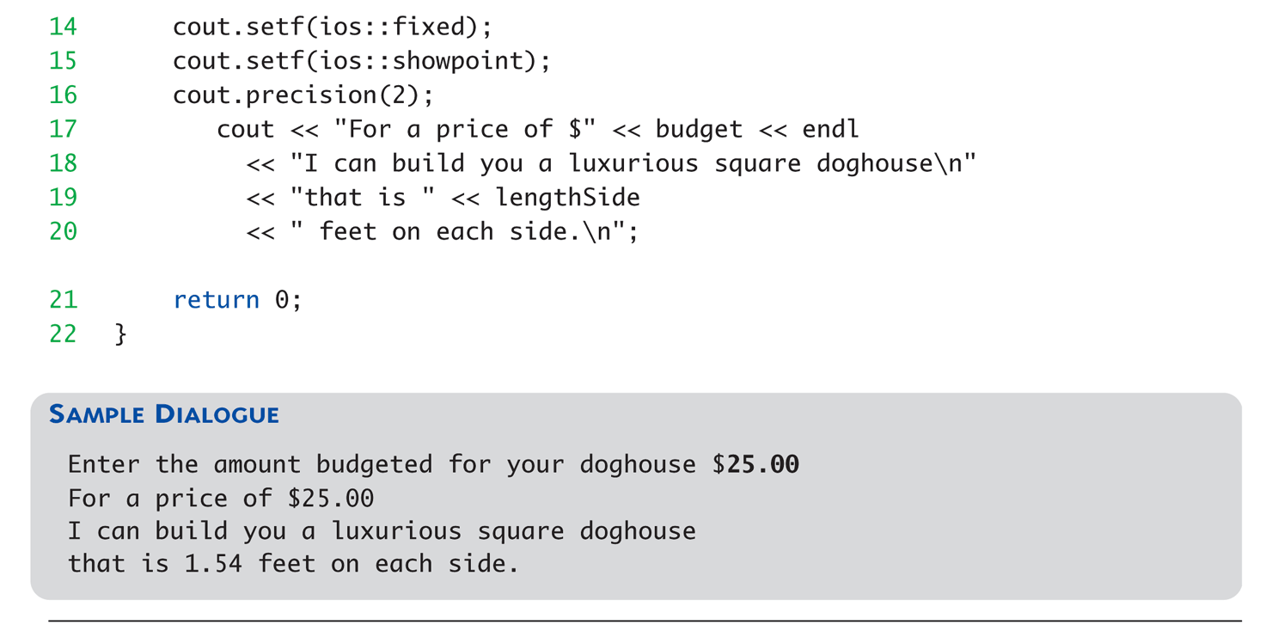
A Larger Example:
Display 3.1 A Predefined Function That Returns a Value (2 of 2)
Copyright © 2008 Pearson Addison-Wesley. All rights reserved.
3-<number>
1-<number>

Slide 38
More Predefined Functions
#include <cstdlib>
  Library contains functions like:
    abs() // Returns absolute value of an int
    labs() // Returns absolute value of a long int
    *fabs() // Returns absolute value of a float
  *fabs() is actually in library <cmath>!
    Can be confusing
    Remember: libraries were added after C++ was
    "born," in incremental phases
    Refer to appendices/manuals for details
Copyright © 2008 Pearson Addison-Wesley. All rights reserved.
3-<number>
1-<number>

Slide 39
More Math Functions
pow(x, y)
  Returns x to the power y
  double result, x = 3.0, y = 2.0;
  result = pow(x, y);
  cout << result;
    Here 9.0 is displayed since 3.0^{2.0} = 9.0
Notice this function receives two arguments
  A function can have any number of arguments, of varying data types
Copyright © 2008 Pearson Addison-Wesley. All rights reserved.
3-<number>
1-<number>
Notes:
Java:
strictfp class MainClass {
public static void main(String[] args) {
// Display the square root of 2 using sqrt()
System.out.print("sqrt(2.0) = ");
System.out.println(Math.sqrt(2.0));
// Calculate and display using pow()
System.out.print("pow(2.0, 0.5) = ");
System.out.println(Math.pow(2.0, 0.5));
System.out.println();
}
}

Slide 40
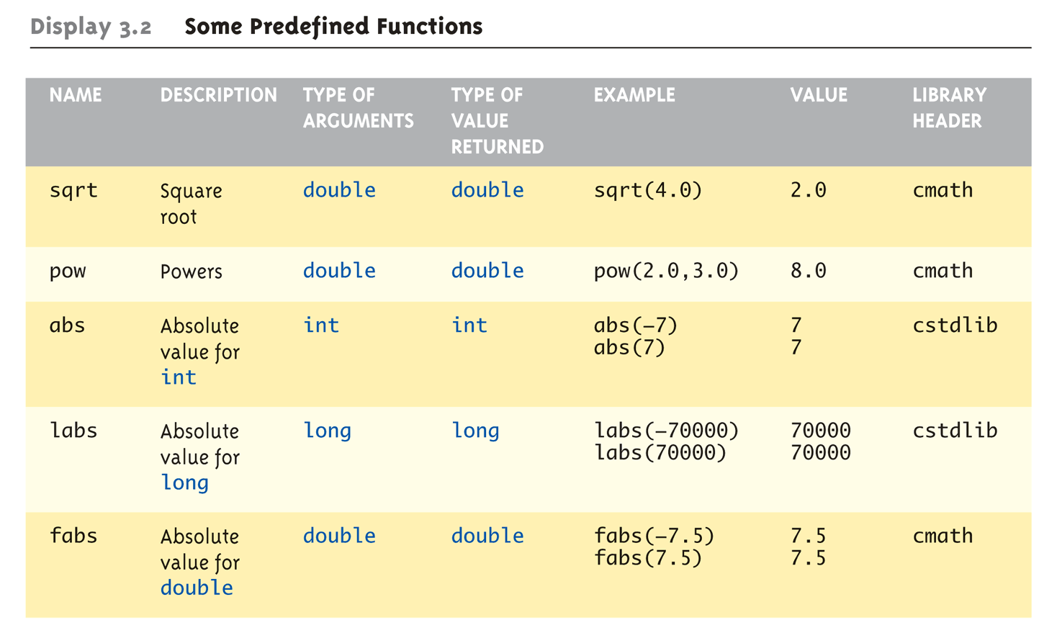
Even More Math Functions:
Display 3.2 Some Predefined
Functions (1 of 2)
Copyright © 2008 Pearson Addison-Wesley. All rights reserved.
3-<number>
1-<number>

Slide 41
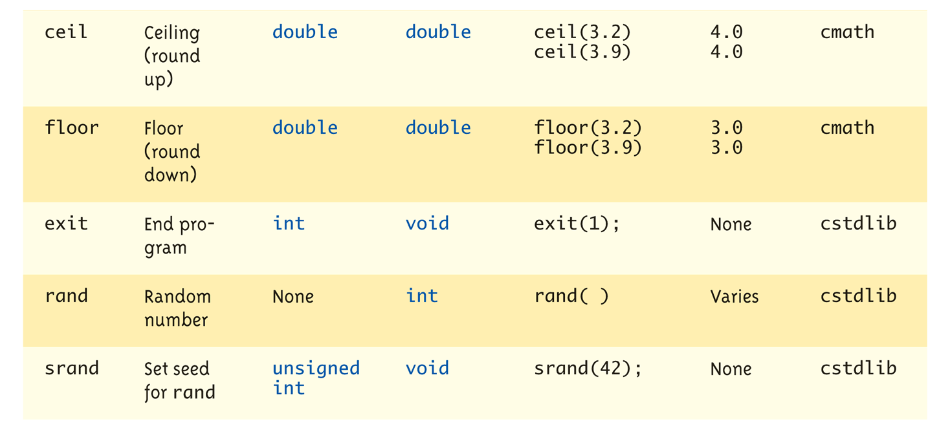
Even More Math Functions:
Display 3.2 Some Predefined
Functions (2 of 2)
Copyright © 2008 Pearson Addison-Wesley. All rights reserved.
3-<number>
1-<number>

Slide 42
Predefined Void Functions
No returned value
Performs an action, but sends no "answer"
When called, it’s a statement itself
  exit(1); // No return value, so not assigned
    This call terminates program
    void functions can still have arguments
All aspects same as functions that "return
a value"
  They just don’t return a value!
Copyright © 2008 Pearson Addison-Wesley. All rights reserved.
3-<number>
1-<number>

Slide 43
Random Number Generator
Return "randomly chosen" number
Used for simulations, games
  rand()
    Takes no arguments
    Returns value between 0 & RAND_MAX
  Scaling
    Squeezes random number into smaller range
    rand() % 6
    Returns random value between 0 & 5
  Shifting
  rand() % 6 + 1
    Shifts range between 1 & 6 (e.g., die roll)
Copyright © 2008 Pearson Addison-Wesley. All rights reserved.
3-<number>
1-<number>
Notes:
See Example: rand.cpp

Slide 44
Random Number Seed
Pseudorandom numbers
  Calls to rand() produce given "sequence"
  of random numbers
Use "seed" to alter sequence
srand(seed_value);
  void function
  Receives one argument, the "seed"
  Can use any seed value, including system time:
  srand(time(0));
  time() returns system time as numeric value
  Library <time> contains time() functions
  What will happen if we remove srand(time(0)) from source code?
Copyright © 2008 Pearson Addison-Wesley. All rights reserved.
3-<number>
1-<number>

Slide 45
Random Examples
Random double between 0.0 & 1.0:
  (RAND_MAX – rand())/static_cast<double>(RAND_MAX)
  Type cast used to force double-precision division
Random int between 1 & 6:
  rand() % 6 + 1
  "%" is modulus operator (remainder)
Random int between 10 & 20:
  rand() % 10 + 10
Copyright © 2008 Pearson Addison-Wesley. All rights reserved.
3-<number>
1-<number>

Slide 46
Programmer-Defined Functions
Write your own functions!
Building blocks of programs
  Divide & Conquer
  Readability
  Re-use
Your "definition" can go in either:
  Same file as main()
  Separate file so others can use it, too
Copyright © 2008 Pearson Addison-Wesley. All rights reserved.
3-<number>
1-<number>

Slide 47
Components of Function Use
3 Pieces to using functions:
  Function Declaration/prototype
    Information for compiler
    To properly interpret calls
  Function Definition
    Actual implementation/code for what
    function does
  Function Call
    Transfer control to function
Copyright © 2008 Pearson Addison-Wesley. All rights reserved.
3-<number>
1-<number>

Slide 48
Function Declaration
Also called function prototoype
An "informational" declaration for compiler
Tells compiler how to interpret calls
  Syntax:
  <return_type> FnName(<formal-parameter-list>);
  Example:
  double totalCost(int numberParameter,
  double priceParameter);
Placed before any calls
  In declaration space of main()
  Or above main() in global space
Copyright © 2008 Pearson Addison-Wesley. All rights reserved.
3-<number>
1-<number>

Slide 49
Function Definition
Implementation of function
Just like implementing function main()
Example:
double totalCost( int numberParameter,
double priceParameter)
{
const double TAXRATE = 0.05;
double subTotal;
subtotal = priceParameter * numberParameter;
return (subtotal + subtotal * TAXRATE);
}
Notice proper indenting
Copyright © 2008 Pearson Addison-Wesley. All rights reserved.
3-<number>
1-<number>

Slide 50
Function Definition Placement
Placed after function main()
  NOT "inside" function main()!
Functions are "equals"; no function is ever
"part" of another
Formal parameters in definition
  "Placeholders" for data sent in
    "Variable name" used to refer to data in definition
return statement
  Sends data back to caller
Copyright © 2008 Pearson Addison-Wesley. All rights reserved.
3-<number>
1-<number>

Slide 51
Function Call
Just like calling predefined functions
bill = totalCost(number, price);
Recall: totalCost returns double value
  Assigned to variable named "bill"
Arguments here: number, price
  Recall arguments can be literals, variables,
  expressions, or combination
  In function call, arguments often called
  "actual arguments"
    Because they contain the "actual data" being sent
Copyright © 2008 Pearson Addison-Wesley. All rights reserved.
3-<number>
1-<number>

Slide 52
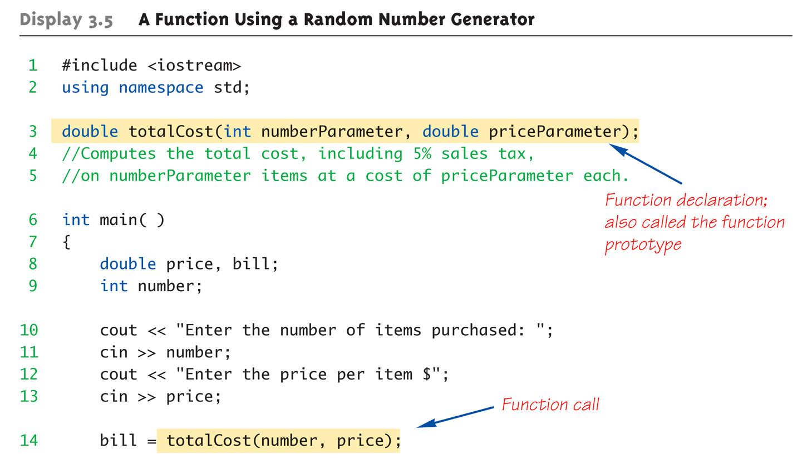
Function Example:
Display 3.5 A Function Using a Random Number Generator (1 of 2)
Copyright © 2008 Pearson Addison-Wesley. All rights reserved.
3-<number>
1-<number>
Notes:
See example: totalcost.cpp

Slide 53
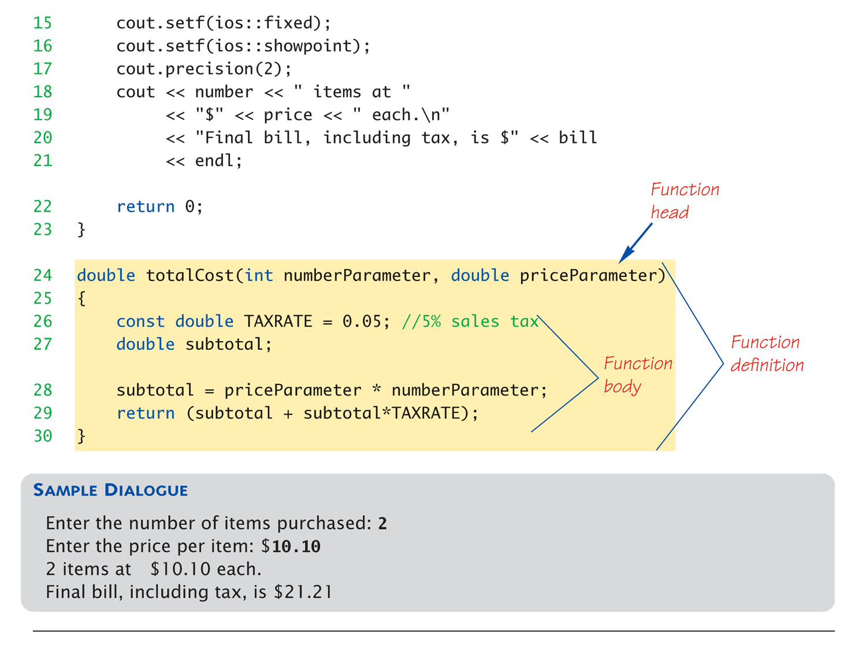
Function Example:
Display 3.5 A Function Using a Random Number Generator (2 of 2)
Copyright © 2008 Pearson Addison-Wesley. All rights reserved.
3-<number>
1-<number>

Slide 54
Alternative Function Declaration
Recall: Function declaration is "information"
for compiler
Compiler only needs to know:
    Return type
    Function name
    Parameter list
Formal parameter names not needed:
double totalCost(int, double);
  Still "should" put in formal parameter names
    Improves readability
Copyright © 2008 Pearson Addison-Wesley. All rights reserved.
3-<number>
1-<number>

Slide 55
Parameter vs. Argument
Terms often used interchangeably
Formal parameters/arguments
  In function declaration
  In function definition’s header
Actual parameters/arguments
  In function call
Technically parameter is "formal" piece
while argument is "actual" piece*
  *Terms not always used this way
Copyright © 2008 Pearson Addison-Wesley. All rights reserved.
3-<number>
1-<number>

Slide 56
Functions Calling Functions
We’re already doing this!
  main() IS a function!
Only requirement:
  Function’s declaration must appear first
Function’s definition typically elsewhere
  After main()"s definition
  Or in separate file
Common for functions to call many other
functions
Function can even call itself → "Recursion"
Copyright © 2008 Pearson Addison-Wesley. All rights reserved.
3-<number>
1-<number>

Slide 57
Boolean Return-Type Functions
Return-type can be any valid type
  Given function declaration/prototype:
  bool appropriate(int rate);
  And function’s definition:
  bool appropriate (int rate)
  {
  return (((rate>=10)&&(rate<20))||(rate==0);
  }
  Returns "true" or "false"
  Function call, from some other function:
  if (appropriate(entered_rate))
  cout << "Rate is valid\n";
Copyright © 2008 Pearson Addison-Wesley. All rights reserved.
3-<number>
1-<number>

Slide 58
Summary
Two kinds of functions:
  "Return-a-value" and void functions
Functions should be "black boxes"
  Hide "how" details
  Declare own local data
Function declarations should self-document
  Provide pre- & post-conditions in comments
  Provide all "caller" needs for use
Copyright © 2008 Pearson Addison-Wesley. All rights reserved.
3-<number>
1-<number>

